Slide 1
CONFIDENTIAL
THE RITZ-CARLTON BAL HARBOUR
POOL CABANA MODIFICATIONS
FEBRUARY 19, 2026
HIGNEY INTERNATIONAL

Slide 2
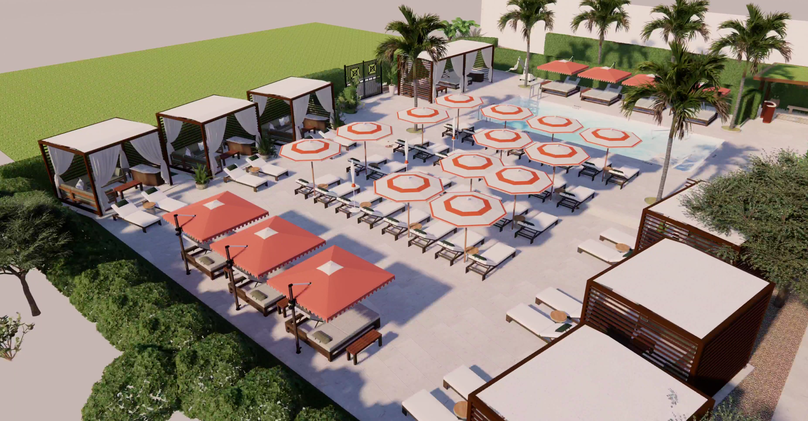
RITZ-CARLTON BAL HARBOUR
CABANA MODIFICATION 01

Slide 3
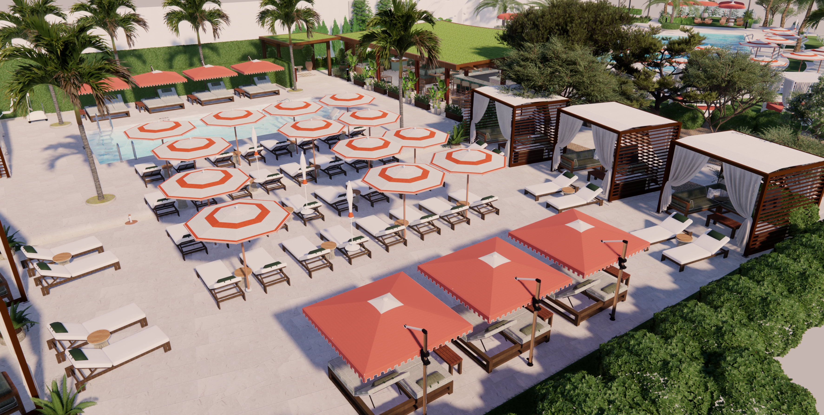
RITZ-CARLTON BAL HARBOUR
CABANA MODIFICATION 02

Slide 4
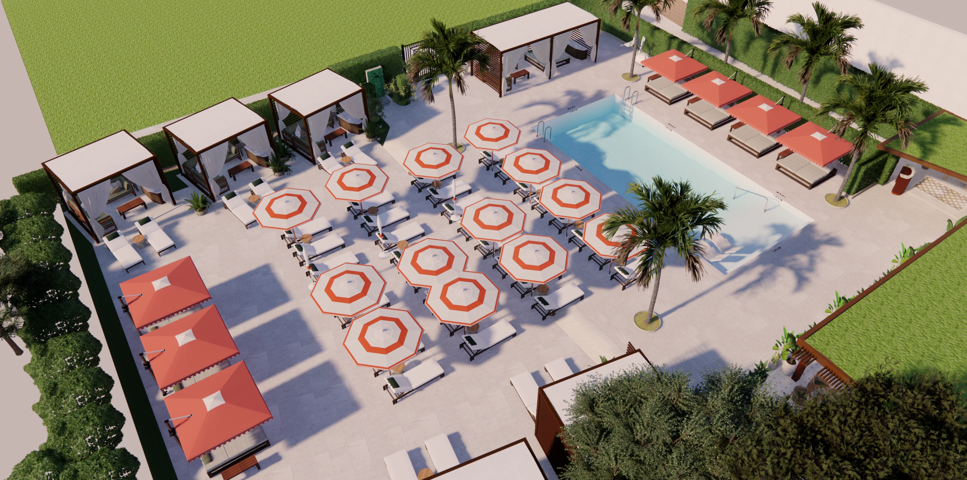
RITZ-CARLTON BAL HARBOUR
CABANA MODIFICATION 03

Slide 5
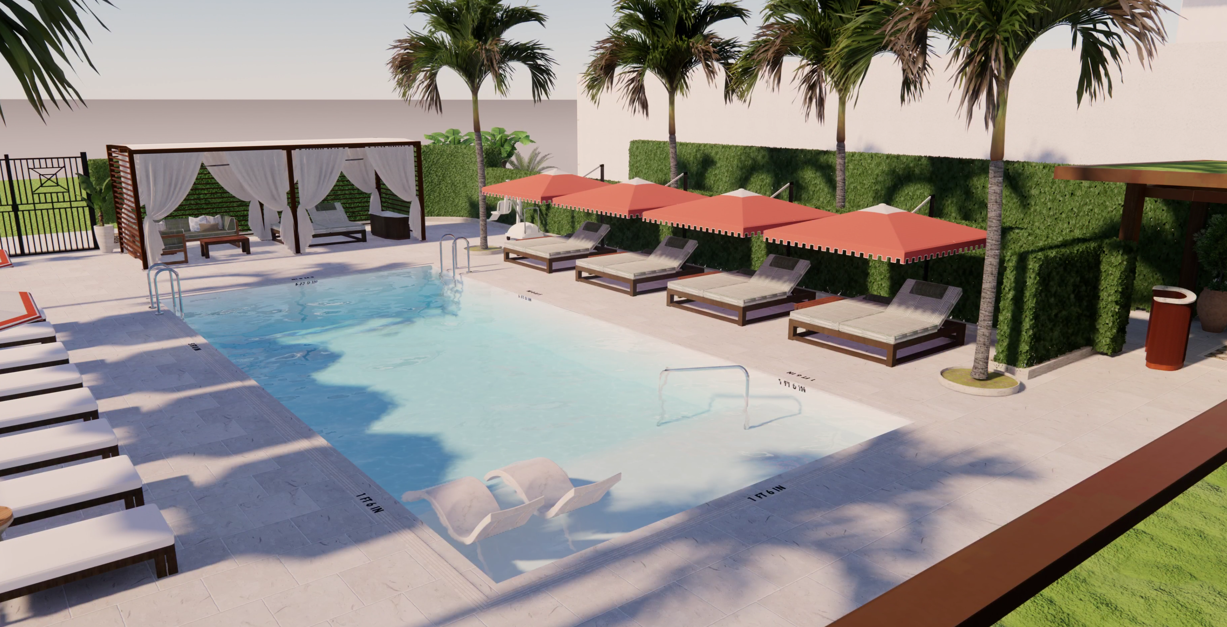
RITZ-CARLTON BAL HARBOUR
CABANA MODIFICATION 04

Slide 6
RITZ-CARLTON
THANK YOU
HIGNEY INTERNATIONAL
1720 HARRISON ST. SUITE 16A
HOLLYWOOD FL 33020
HIGNEY-INTERNATIONAL.COM

